Slide 1
Document Understanding
Project Management
Presentation by Anthony Garcia
04/19/2021

Slide 2
Table of Contents
Start With Why?
Work Breakdown Structure
How Did We Pull This Off?
Where Do We Go From Here?
References – Brainshark / Slack / Highspot / Academy / Forum

Slide 3
Why document processing? Why now?
Every company
Manual & time-consuming
COVID-19
Legacy systems
Lack of end-to-end solution
Competitiveness
Target industry:
BFSI, healthcare, public sector
Target domain:
finance, supply management, HR, legal, compliance
Decision maker:
C-level executives (usually CIO, CFO, CEO), LOB Senior Management
Notes:
[Talk track:
Now as you can imagine, Document Understanding has broad applicability to UiPath’s customer base.
We know that:
Every company in the world deals with document processing. Usually it’s a manual time-consuming task
This becomes especially challenging in the Covid-19 world when the teams need to work from home
The legacy systems still used in many organization across industries are not making it any easier
and of course, RPA & AI can help businesses get up to speed and differentiate them at the market
[click]
UiPath Document Understanding enables UiPath’s RPA platform to become an end-to-end platform for intelligent automation for many different industries and domains, such as Banking, Insurance, Healthcare, Public Sector, Finance, and Legal departments. This pitch should be directed at senior management to land the power UiPath’s full hyperautomation platform including document processing capabilities.

Slide 4

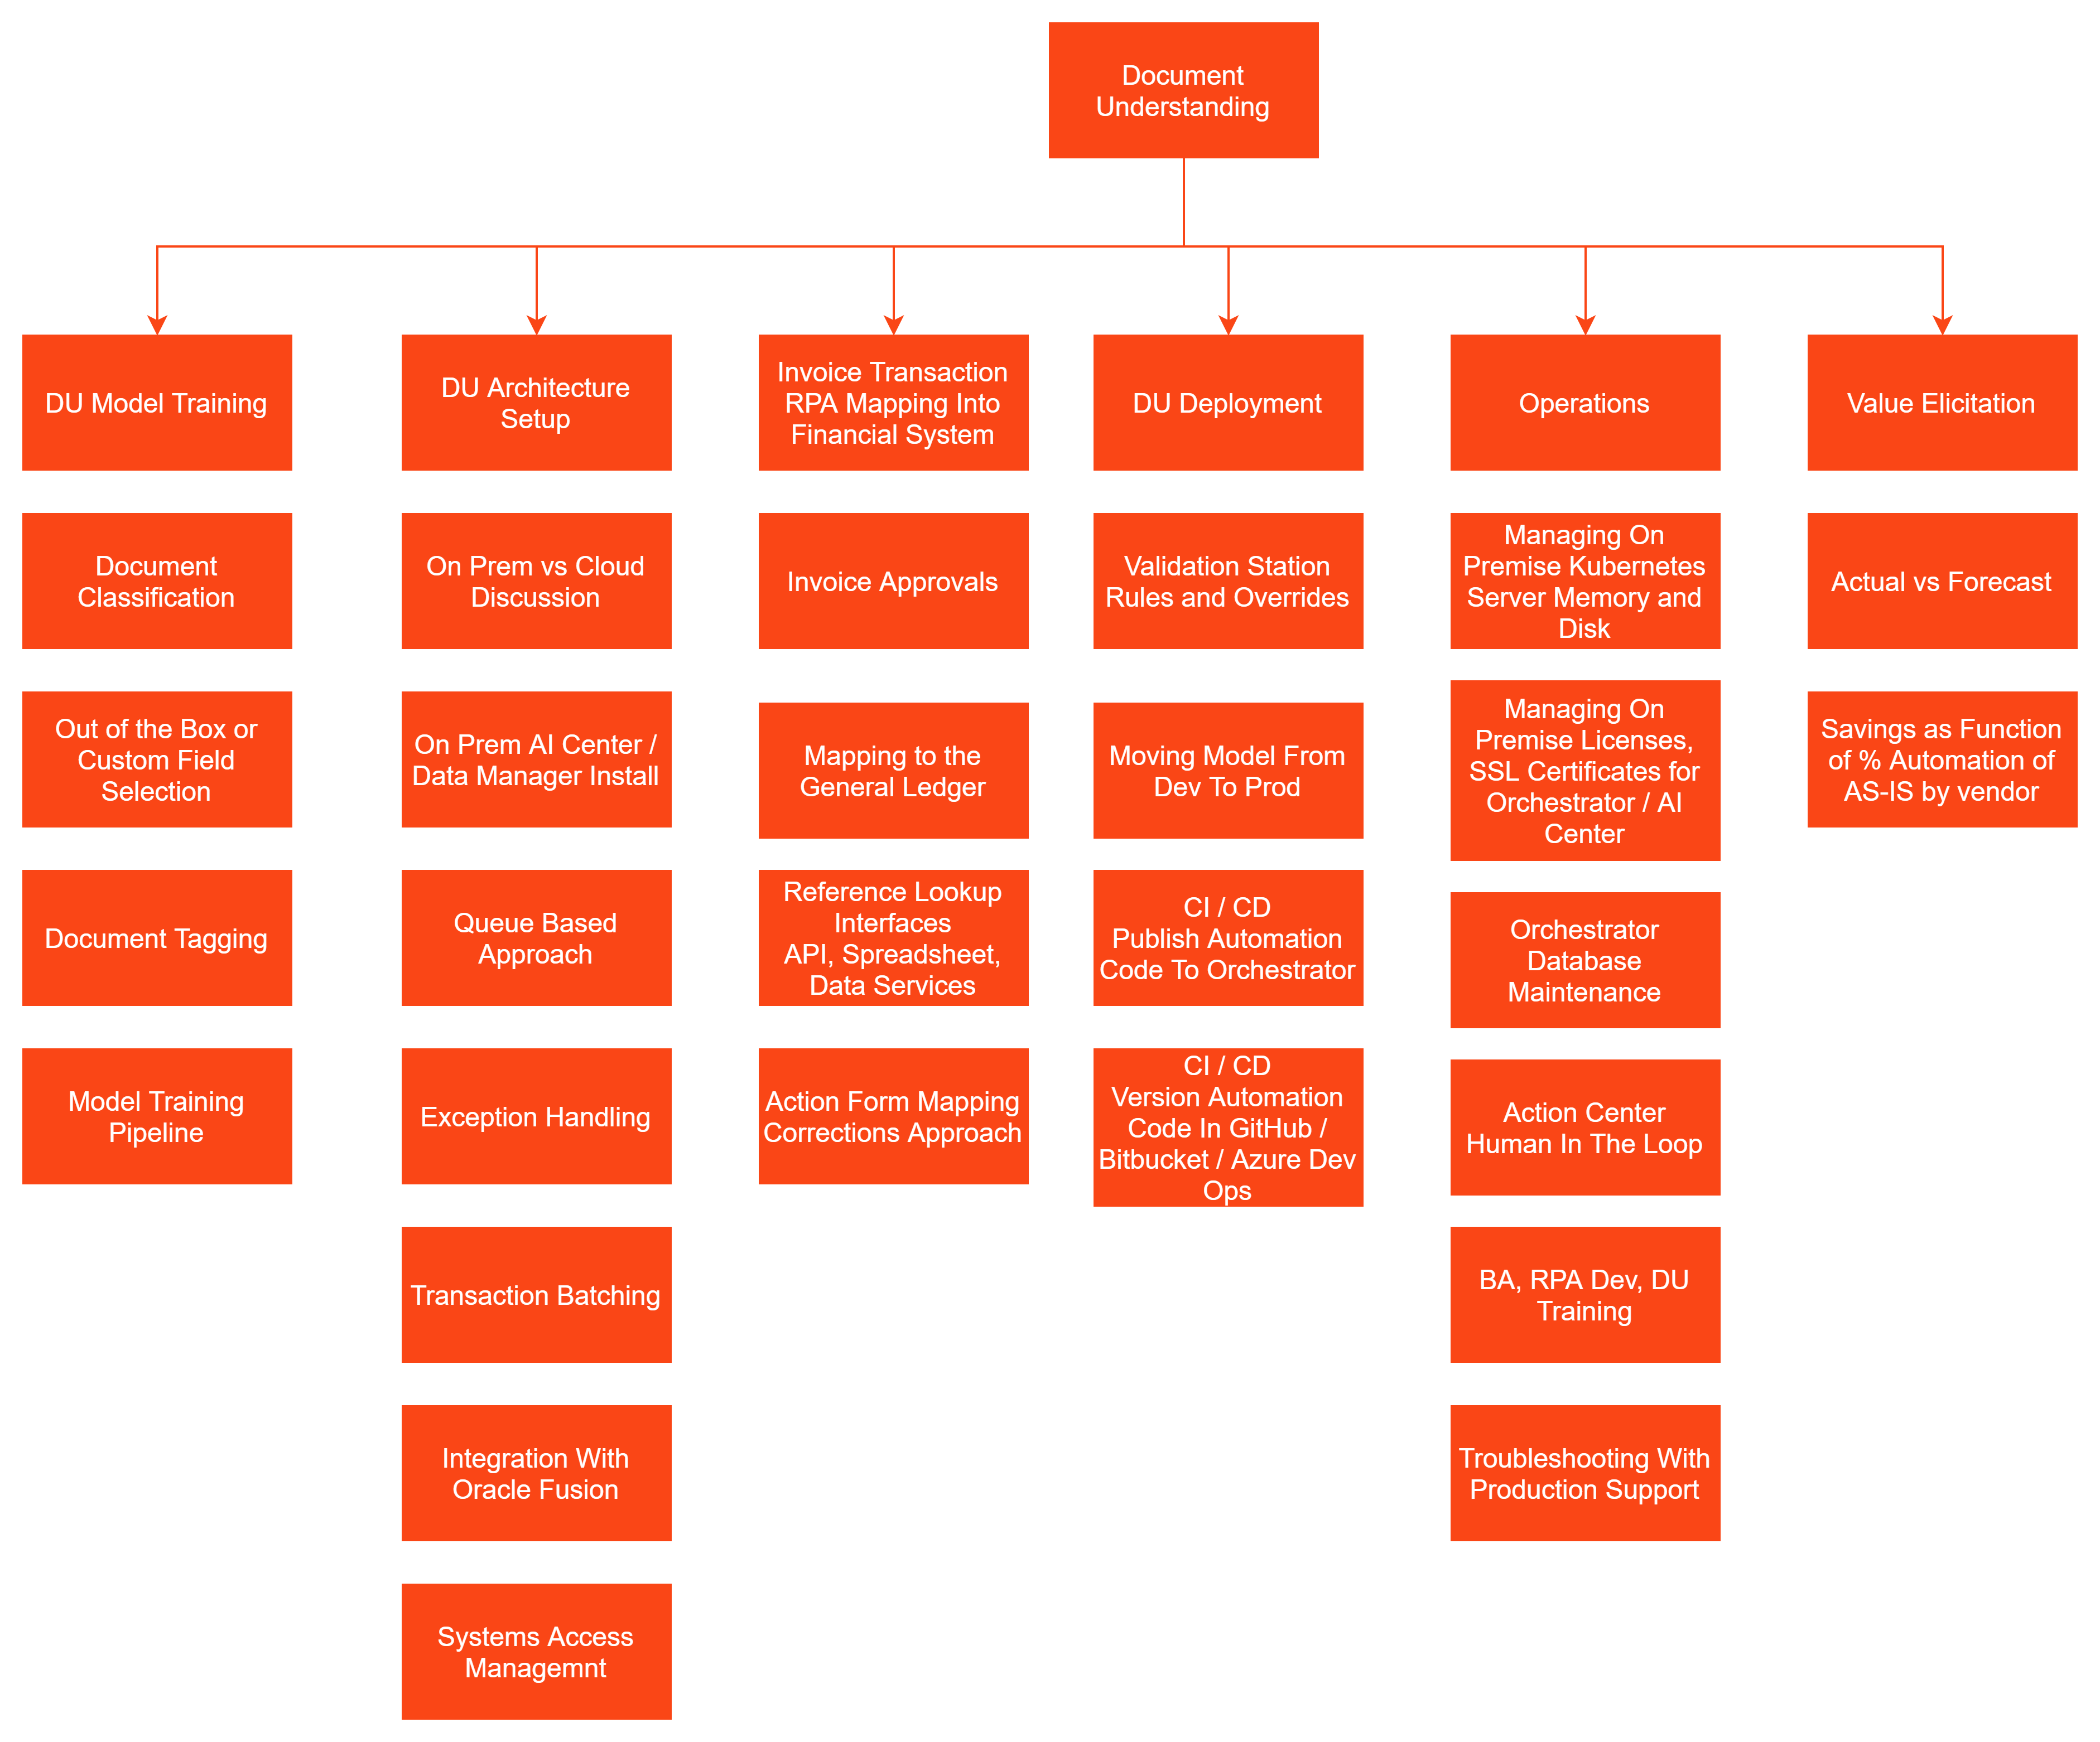
Work Breakdown Structure
Document Understanding

Slide 5
How Did We Pull This Off? A Fine Line Between Insanity and Genius
Document Understanding
No Formal Billable Solution Architect Assigned
Original Account Executive Exits Company
Customer Infra Had Little Experience With Linux
Demonstrated Investment/Commitment by all UiPath Resources (AE, CSM, PS US/Rom) to make progress
Deeply Discounted Page Views To Burn During Development
Dev / Support Role Coverage / Handoff Across Timezones
Project Manager
Assigned At Lower Rate
Change Request That Doesn’t Get You To Finish Line
On-Premise DU Installs Better On Some Flavors Of Linux
Large PS Investment And Delivery Leads To Service Credit and Other Projects
Program Management Mentorship From
Andrew Clemmensen
Losing Assigned Resources To Other Projects
On-Premise Installs Taking Inordinate Amounts of Time And UiPath Resources
Generous Enterprise Trial License For Several Months
COVID Related Resouce Issues
Use of Internal Infra Until Customer Data Manager Working
UiPath Culture Allows For Many Hours of Free Help/Advice From Others With Inflight DU Projects
Large Gap Between Estimates and Customer Expectations
Asking Customer To Drop 2 Use Cases To Save 3 Use Cases
Customer Did Not Own Action Center And Only Had One Attended License
Not Enough Licenses For Dev Team

Slide 6
How Did We Pull This Off? - Business Case
Seeking input on the As-Is FTE, automation %, and fully loaded cost per FTE
For model trained vendors we expect a high automation %; for non-trained vendors we expect a low automation %
The automation % below assumes the solution will be rolled for ALL invoices
We intend to refresh the automation 64% once the solution is in production based on actual results

Slide 7
How Did We Pull This Off? – Change Request Difficult Discussion - Remaining Work and Options
Time to date has exceed the current contract by ~235 hours
UiPath estimates ~160 hours are required to reach the definition of done
This would cover enhanced reporting for transaction tracing, UAT, DU model re-training for 6 vendors, support for mapping tests, and migration to Production.
Seek direction on options (two are listed below)
Option 1: Stop work and rely on Pacific Dental to complete the remaining activities
Option 2: Execute a change order and continue work
In this option, UiPath would be willing to cover the 235-hour (~$61K) overage if Pacific Dental covers the 160-hour remaining forecast ($24K)

Slide 8
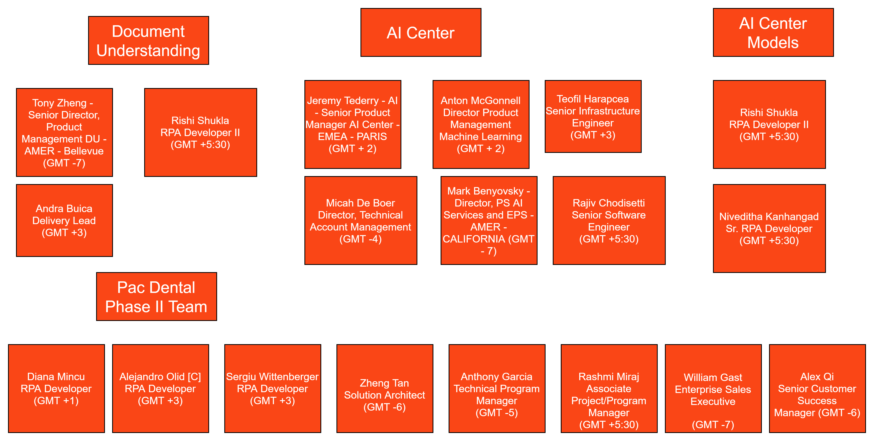
How Did We Pull This Off? UiPath Culture – Humble Bold Immersed Fast
Document Understanding

Slide 9
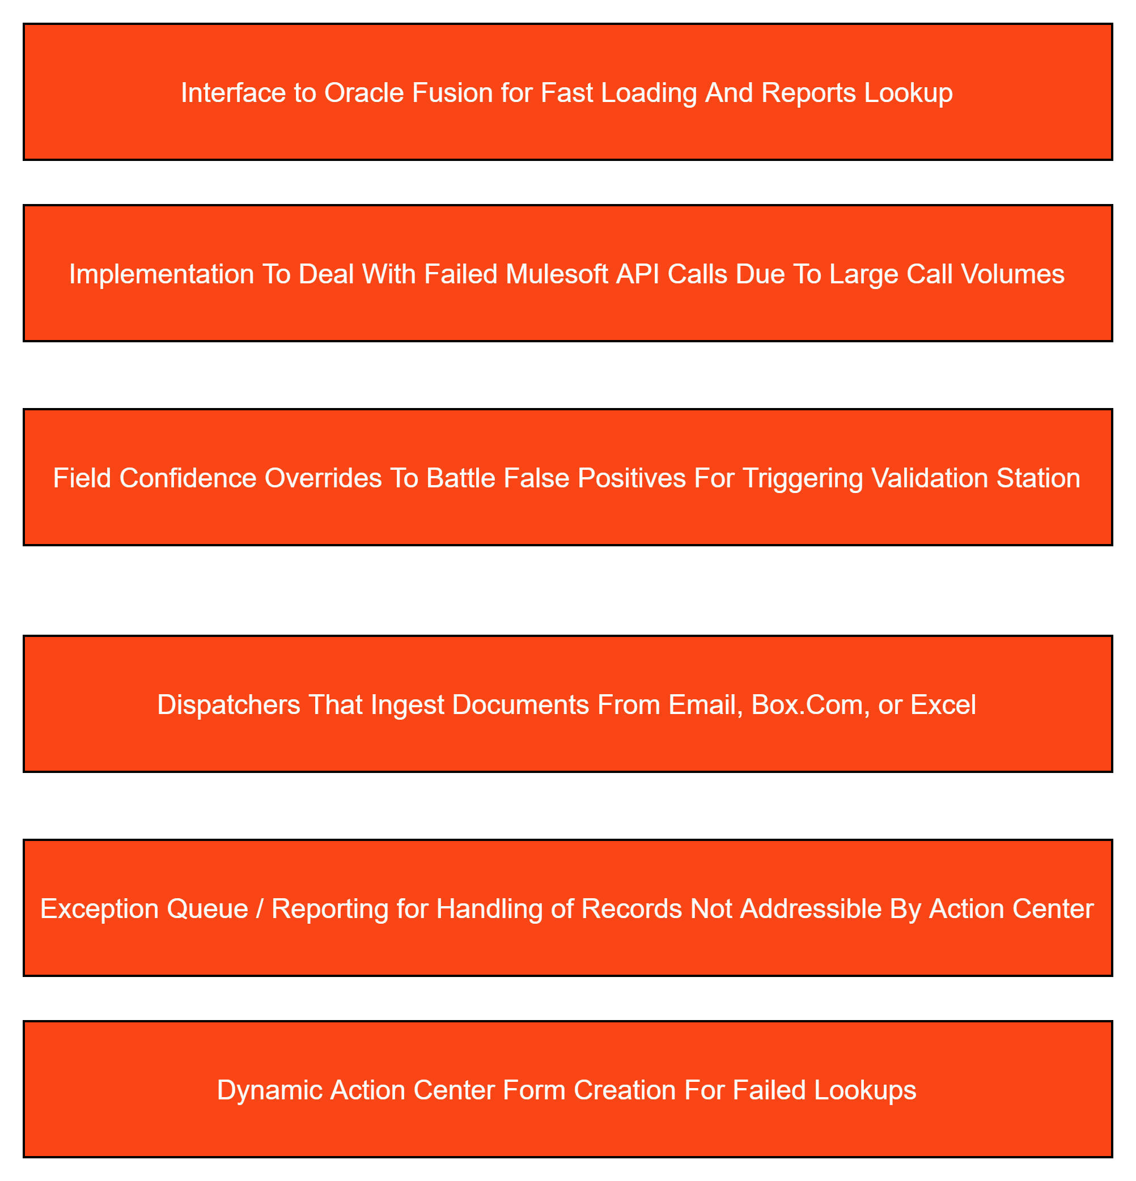
Where Do We Go From Here? Share Project Driven Innovations with Document Understanding Framework
Document Understanding

Slide 10
Where Do We Go From Here?
Document Understanding
DU Project Management Framework
Document Understanding Framework
Document Understanding BPO
Document Understanding Derivative Project Expansion
Document Understanding Partner Trainings Addition
Document Understanding Presales/Sales Knowledge Sharing
Document Understanding Marketing
Document Understanding Product Feedback

Slide 11
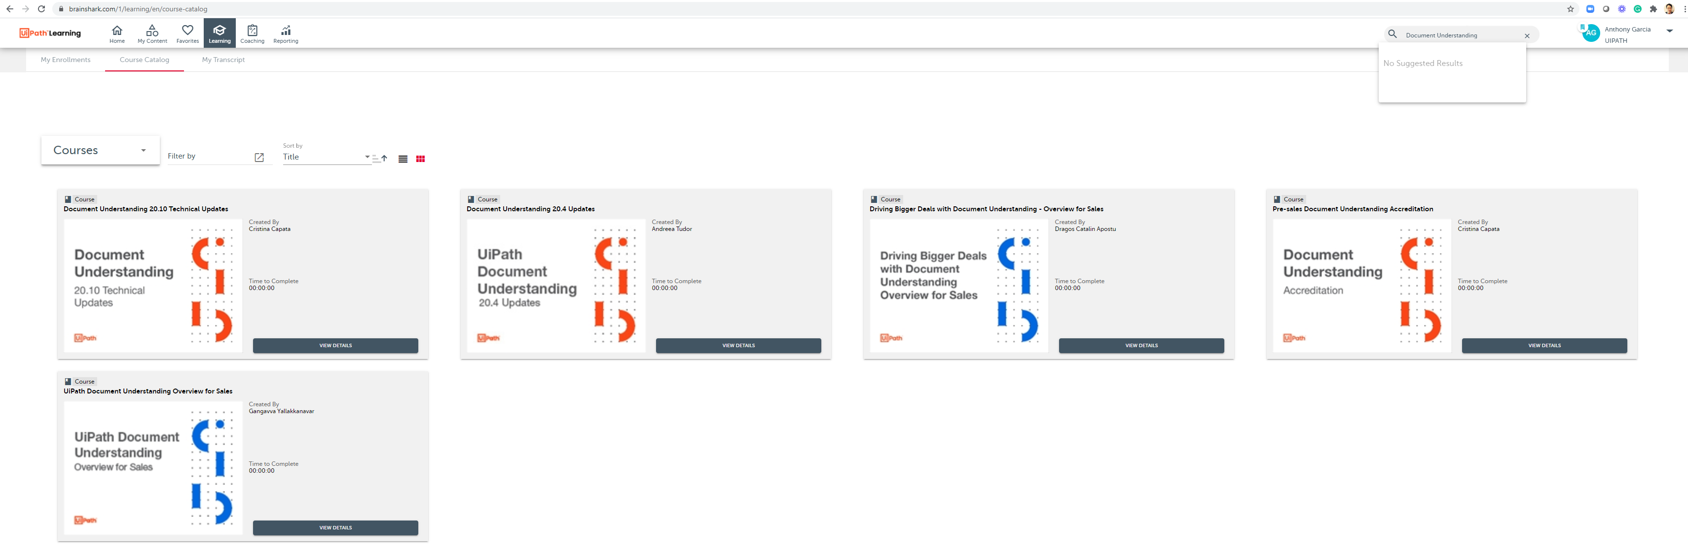
References Brainshark
Document Understanding

Slide 12
References SLACK
Document Understanding
Primary | Other AI/DU Channels | Other AI/DU Channels | Projects
#help-documentunderstanding | #ai_fabric_ninjas | #du-activities-ux | #proj-novonordisk
#help-aicenter | #du-cloud-infra | #du-activities-releases | #proj-pacific-dental
[Teams/Framework] | #du-cloud |  | #du-nissan-solution
#document-framework-india | #du-automation-efforts | #du-on-aifabric | #proj-aif-on-aks-pepsi
#emea-documentprocessing-team | #du-app | [Kubernetes OEM] | #intel_document_understanding
#du-framework | #du-aif-testing-pipelines | #partner-replicated | #ici-document-understanding
 | #du-aif-multiregion-support |  | #proj-bfsi-du-aif

Slide 13
References Highspot / Academy / Forum
Document Understanding
Highspot - https://uipath.highspot.com/items/5e986ae8a2e3a90459b72669?lfrm=srp.0
Document Understanding Overview - https://academy.uipath.com/learningpath-detail/3004/3/0/3
Document Understanding Tutorial - https://academy.uipath.com/learningpath-detail/3011/3/0/3
Forum - https://forum.uipath.com/c/build/document-understanding/110

Slide 14
USER ACCEPTANCE TESTING CANDIDATES
Document Understanding
Happy Path
Document Model Behavior / Accuracy By Vendor
RPA Exception Handling
Dispatcher
Action Form Validation
RPA Exception Handling Performer
Skill Pipeline Execution
Performance Testing
Exception Reporting and Resolution

Slide 15
Driving BIGGER deals with Document Understanding (DU)
Customer | UiPath Deal Value | Competition
BenefitMail | $101K | AA, ABBYY
BJ’s Wholesale | $471K | Automation Anywhere
Canada Pension Plan Investment Board (CPPIB) | $402K | Blue Prism, SortSpoke
Centers for Medicare & Medicaid Services | $363K | Blue Prism, ABBYY
Florida Department of Economic Opportunity (FL DEO) | $505K | AA, ABBYY
Golden1 Credit Union | $247K | AA, ABBYY
HP Inc. | $1.5M | MS Power Automate
iMed | $101K | AA, ABBYY
Kaiser Foundation Hospitals | $544K | AA, Blue Prism
OneTrust International | $113K | Automation Anywhere
Ontario Municipal Employees Retirement System (OMERS) | $605K | Blue Prism
Pacific Dental Services | $250K | Pegasystems, ABBYY
Palo Alto Networks | $1.1M | Live Objects
Wayfair | $147K | Hyperscience
Document Understanding plus:
AI Fabric
Action Center
Robots
Orchestrator
Studio
Professional Services
HAPO
New Business
As of October 2020
Notes:
[Please make sure to highlight the following:
DU deals can be substantially sized deals
DU can help us win new logos
DU can win against competitors. Address top reasons for losses 1) price, 2) product gaps, 3) product maturity and how we’re working on those.
The potential is huge for many companies – any big enterprise has lots of documents to process. If you want to, you can mention that we have been talking to customers aiming to process about 2M and even 60M documents annually with DU. Should we touch upon new SKUs here and that they are stackable?
Mention that DU deals bring more revenue to UiPath not only with selling DU licenses, but also selling other products needed for document processing workflows (products on the slide). How DU becomes a catalyst for those bigger deals]

Slide 16


What is Document Understanding?
GOVERN
Teach robots to understand documents
using artificial intelligence (AI)
Task Mining
Studio Family
Process Mining
End-to-end solution for document processing
AI-enabled capabilities
Works for a wide range of documents
Offers pre-trained models for most common use cases
Enables model retraining for custom documents, including automatic retraining based on human validation
Recognizes handwriting, signatures, checkboxes
Processes different file formats (image, text, PDF) and quality (rotated, skewed docs)
Document
Understanding
Task Capture
DISCOVER
BUILD
Marketplace
and
Integrations
Automation Hub
Robots
RUN
Chatbots
Orchestrator
ENGAGE
MANAGE
Action Center
Test Manager
Assistant
AI Fabric
Apps
Insights
MEASURE
Notes:
[Briefly remind the audience what is DU touching upon the things mentioned in the list]
Let’s start with what is Document Understanding.
Document Understanding is a solution for addressing document processing workloads. It is not a standalone offering – instead, Document Understanding is intended to enhance the capabilities of the UiPath RPA platform with document ingestion and comprehension abilities.
Document Understanding sits within the “Build” portion of the hyperautomation flywheel, but also works closely with other parts of the UiPath platform such as “Manage” with Orchestrator and AI Fabric, or “Engage” with Action Center and Apps.
Document Understanding is designed to work with a wide range of documents ranging from structured forms with repeating formats, handwritten forms, or semi-structured documents where data may appear in different places throughout the document and with differing labels from document to document.

Slide 17




Customer value drivers
Accelerate operational efficiency
Spend less time and costs on operational tasks and more on the real business investments
Improve customer experience
Win customers’ respect – accelerate the speed of response to show how you value their time
Improve employee experience
Save employees from mundanity and let them focus on higher value tasks and objectives
Operational Resiliency & Risk Mitigation
Minimize and manage enterprise risks, and ensure compliance & operational resiliency
Notes:
[Talk through each block to explain the product value, don’t spend much time here]
As a result, Document Understanding can create significant value for customers, ranging from accelerating operational efficiency to improve experiences for customers and employees or even reducing enterprise risk ensuring compliance and operational resilience.

Slide 18
Every company in the world processes documents
General | Financial Services & Insurance | Human Resources (HR) | Manufacturing | Public Sector | Healthcare
Invoice Receipt Purchase Order Utility bill Bill of Landing Passport License | Accounts Payable & Accounts Receivable IRS form Loan application Mortgage processing Account opening and customer onboarding Claims processing Vendor onboarding Compliance-related processes | Employee onboarding Resume screening HR records processing | Sales order processing Customer parts request Remittance processing | Immigration application School application Passport management application | Medical forms Medical bills Health records Drug prescriptions
Notes:
[Do not spend much time on this one. Just reiterate that there are so many use cases for DU in various industries and domains, including some general use cases that would work probably for every enterprise (may be a hint where to start) – like processing invoices, receipts, purchase orders, utility bills, passports, licenses, and so on. Tell them they can pause the video if they’d like to look through all these use cases, or they can find them at HighSpot]
In terms of use cases, there are many many target use cases for Document Understanding. This slide shows a few examples – I will not spend much time here, but feel free you pause the video if you want to look through these use cases, or look at the Document Understanding page on HighSpot for more detailed information.
The point is, there are many use cases beyond the traditional invoices and receipt uses cases that can be easily enabled with Document Understanding, and with the document autoML capabilities we have built into Document Understanding, you do not need to be afraid to target a use case for which we do not have a pretrained model for yet – there’s a good chance that the use case could be addressable by Document Understanding.

Slide 19







How does it work?
And what’s new in 20.10?
Retrain
Retrain
Load taxonomy
Digitize
Classify
Extract
Validate
Export
Define document types and fields for extraction
Obtain machine readable text using OCR if necessary
Split files into document types a data culture
Use different methods to extract document information
A human can help confirm classification or data extraction results
New business models extract information for further usage
20.10 LTS release +
Automatic model retraining based on human validation
Intelligent document classification & Classification Station
Document Understanding model deployment using UiPath AI Fabric – both on-prem and cloud
Improved recognition for both standard text and handwriting
UiPath Document OCR
* Models in preview: Purchase Orders, Utility Bills, Invoices for India, Australia, and Japan
* ML Classifier and retraining – post 20.10
Notes:
So, how does it work? At the high level, we start with the Document Understanding for building a typical document-focused workflow.
This workflow starts with loading a taxonomy to define document types and fields for processing. Then the document gets digitized, that is converted to a machine-readable format using OCR. Next, documents can be classified and split into different types, and then data can be extracted using different approaches including both rules-based and AI-based methods.
[click]
If there are any inaccuracies or exceptions, the documents can be sent for human validation to correct and confirm the results of document classification and data extraction. With the 20.10 LTS release, customers can also use the human validated output to retrain their machine learning models to improve the accuracy over time.
Finally, for post-processing, you can export that data to the relevant systems and the robot can continue working on the end-to-end task. You can learn more about the Document Understanding product functionality in the Q2 2020 course on Document Understanding.
[click]
Apart from model retraining, some other long-awaited capabilities will be released to GA in October 2020. Some highlights include:
Automatic model retraining from Validation Station
Advanced classification and document splitting capabilities including a new human-in-the-loop interface called Classification Station
Additional integration with AI Fabric including support for on-prem, airgapped deployment models as well as a preview capability to run Data Manager inside of AI Fabric
And of course, improvements to our UiPath Document OCR and handwriting OCR capabilities, including moving UiPath Document OCR to General Availability.
Folks, if you have not yet tried UiPath Document OCR, please try it out – this is built on the same technology as UiPath’s Computer Vision capabilities which enables UiPath robots to “see” selectors even in virtualized desktop environments. UiPath Document OCR is fantastic, it’s available both cloud and on-prem, and it’s free with your UiPath licenses. Please encourage your CSM or pre-sales teams to try it out if they are not using it yet!

Slide 20
Why UiPath? Key differentiators
UNIQUE
[Only UiPath has it]
End-to-end document processing automation: UiPath Document Understanding + UiPath RPA Platform
Hybrid approach to data extraction: Apply various extractors even to the same field or page of a document
COMPARATIVE
[UiPath does it better than competitors]
Processing of a wider range of documents: UiPath Document Understanding + Partner Ecosystem
Pre-trained ML models: Invoices, Receipts in GA, Purchase Orders, Utility Bills, Invoices for India, Australia, and Japan in preview; custom model creation
Human validation and retraining of ML models via Validation Station: Constantly improve the accuracy
Notes:
Now, let’s talk about some of the differentiators of UiPath Document Understanding.
First and foremost, Document Understanding is a platform play that enables the UiPath RPA platform to perform better. You need to tell our customers that they don’t want a document processing solution that does a little bit of automation – they want an automation platform that can also process documents. This of course also means that customers can benefit from the rest of the capabilities the platform provides as well, from better management and scaling of their document solution through AI Fabric and Orchestrator or Cloud Platform, to better human in the loop experiences through Action Center and Apps.
Next, Document Understanding can process a wider range of documents than competitive offerings. Some competitors can handle forms, or certain semi-structured documents like invoices, or even some ML scenarios as point solutions. However, customers don’t want to implement point solutions for each use case and end up in with a complex, multi-vendor vendor environment. Instead, they are better off selecting the right long-term vendor to partner with which can extend to all their needs through a single offering.
Finally, Document Understand was built to provide customers with an open and composable framework that offers a more future-proof option than alternative offerings. With our framework, customers can use UiPath technology alongside partner technology or even their own custom technology. We publish contracts for every part of our framework which means customers have the flexibility to deploy their own custom OCR engine if they want to, or create their own custom classifier. Customers can utilize hybrid approaches to data extraction which means they could run multiple different extraction methods including combinations of UiPath and third party extractors, all side-by-side.
All together, UiPath has a broader, more comprehensive vision for the document processing space than other RPA platform competitors or what can be offered by niche players focused exclusively on document processing.
End-to-end document processing automation - you don’t want a document processing technology with little automation, you want an automation platform processing documents. Usually IDP tools are all about pre-processing and intake of docs, while UiPath offers a leading platform for post-processing
Hybrid approach – apart for flexibility and ease of use, it allows to receive more accurate data
Wider range of docs – mention also handwriting and a composable framework allowing to create/add custom components as OCR, classifiers, and extractors
Pre-trained models – emphasize that we can have more OOB models if customers share the docs with us, and they can create custom models via AIF
Retraining improves the accuracy over time, thus human validation will be less and less needed
Address key loss factors – high pricing, evidence of product maturity (including analyst reports)]

